Slide 1
Building Office Add-ins for Microsoft Outlook
Mail Add-in Basics

Slide 2

Mail Add-in Basics
Why Modern Add-ins
Types of Mail Add-ins
Provisioning Add-ins

Slide 3

Office 365 Platform
EXTENSIONS
Common across canvases
Action
Task pane
Dialog box
Event
DOCUMENTS
PAGES


CONVERSATIONS
CANVASES
Canvas specific
extensions
Data import
Dictionary
Connectors
Actionable emails
Navigation
Branding
Notes:
The Office 365 Platform offers a number of canvases for developers to embed customizations. Office add-ins are one of those canvases.

Slide 4
Historical Add-in Challenges
Where can I find a great add-in to help me in Outlook?
We have 100K employees…how will we distribute???
Proprietary Development
Discoverability
Decentralize Distribution
Updates/Upgrades
Devices/Mobility
Internet Ready
Will it work on the latest version of Office?
I have a great add-in idea, but come on…COM, VBA, and VSTO Development…REALLY?!?!
Can it run on my iPad?
v
v
My Chromebook has an awesome browser!
Notes:
Traditional Office add-ins have been built using old or proprietary development technologies like VBA, COM, and VTSO
(ok…our developer got past the development tools and built a great Office add-in…but how are people going to find it?)
Great Office add-ins were hard to find as there was no centralized marketplace to find them
(ok…lets say people find the great Office add-in…what about distribution)
Traditional Office add-ins were installed along side Office and execute with Office, meaning you have to distribute it
What if you want to upgrade to a new version of Office…does the add-in support that? How many of you have heard of someone stuck in an old version of Office because of an add-in?
We are living in a mobile world these days and users want to be productive on the go…traditional add-ins certainly won’t install on mobile devices
We are also living in an age were many users just want to use a browser…traditional add-ins can’t run in Office Online

Slide 5
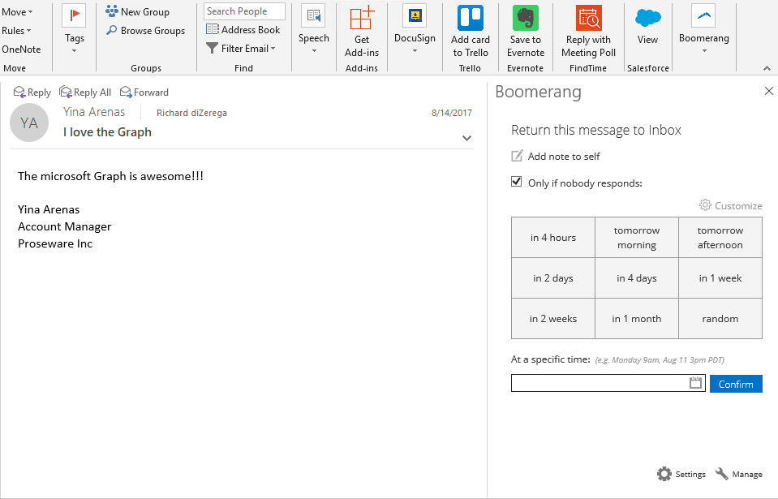

Modern Add-ins Value Proposition
Centralized deployment on web server
Built with web standards
Office.js provides interop
Hosted centrally
Almost zero client footprint
Runs where Office runs
Discoverable marketplace
Marketplace
Office.js

Slide 6
Types of Mail Add-ins

Slide 7
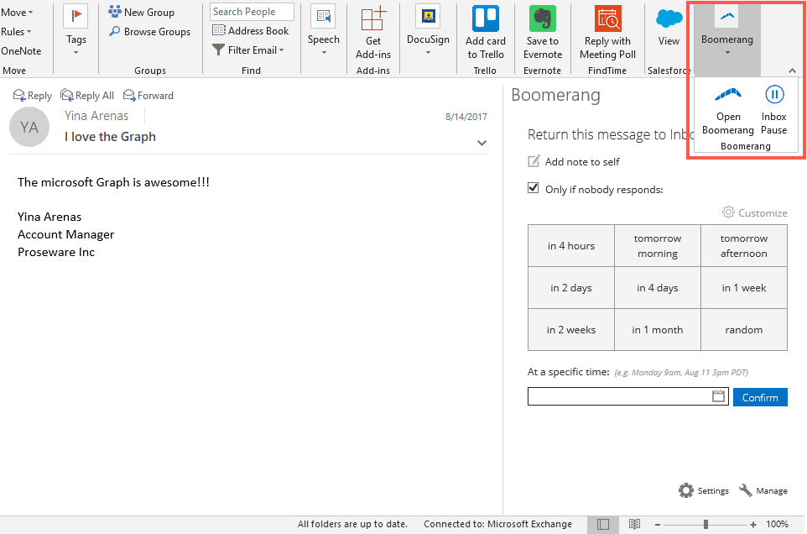
Types of Mail Add-ins
Add-in commands and actions
Initiate specific add-in actions from the ribbon by adding buttons or drop-down menus.
Add-in commands can launch a task pane add-in with context to the selected message. These task panes can even be pinned to stay open.
Add-in commands can execute a JavaScript function for scenarios where the user doesn't need to make any additional selections to initiate the action.

Slide 8
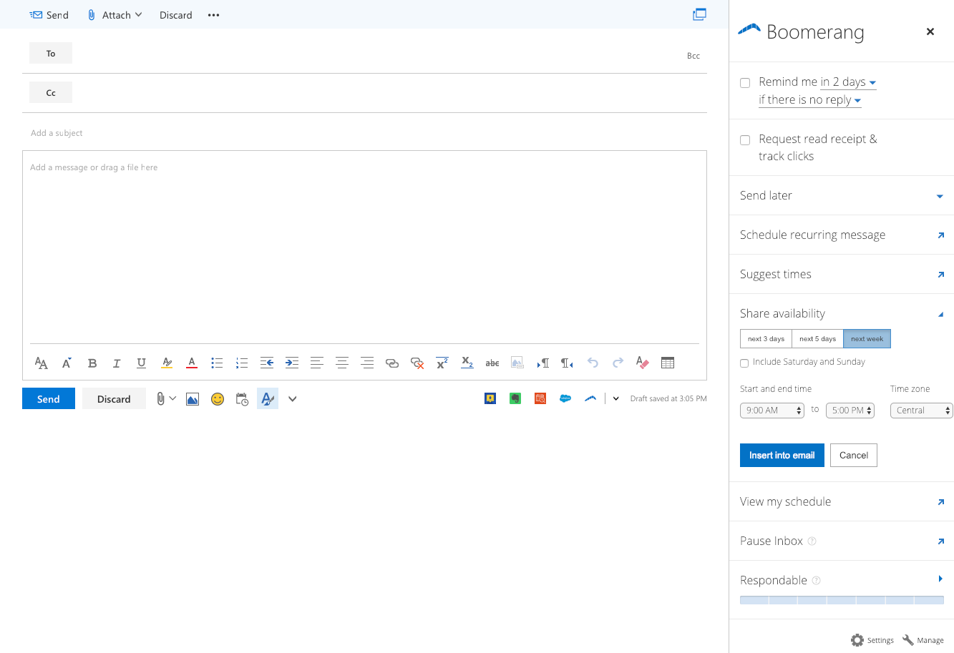
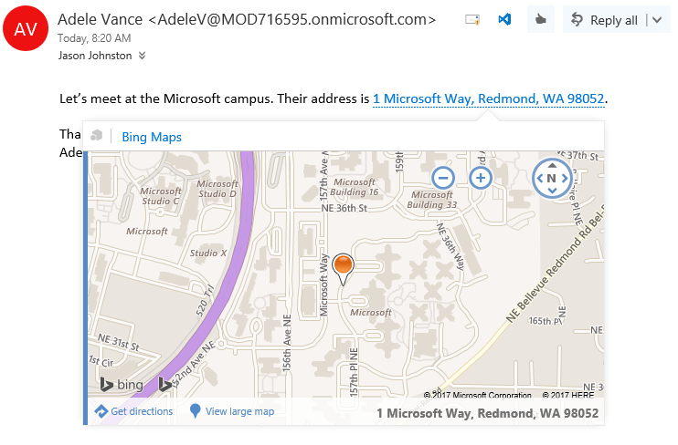
Types of Mail Add-ins (cont.)
Message compose add-ins
Outlook add-ins activated in compose forms to help author a message, meeting request, or appointment.
Contextual add-ins
Contextual add-ins are Outlook add-ins that activate based on text in a message or appointment that matches a known type (ex: address, meeting suggestion) or regular expression.

Slide 9
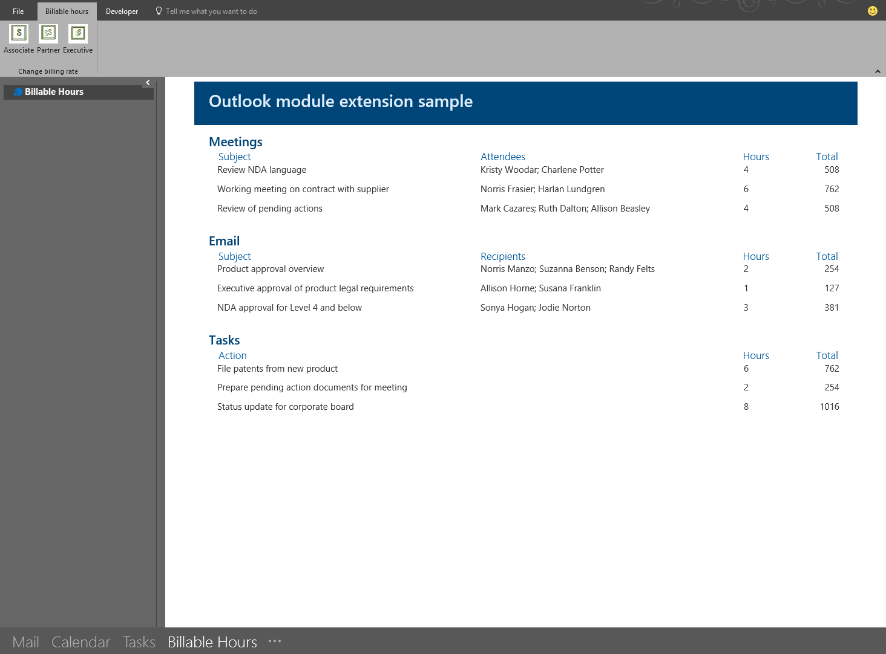
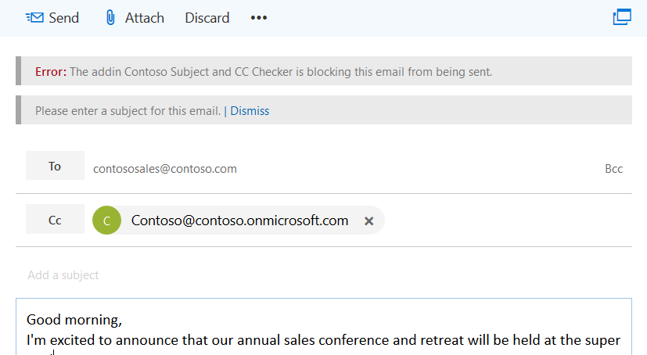
Types of Mail Add-ins (cont.)
Module extension add-ins
Module extension add-ins appear in the Outlook navigation bar, right alongside mail, tasks, and calendars allowing you to embed almost any applications inside Outlook.
On send add-ins
The on send feature for Outlook add-ins provides a way to handle email or block email users from certain actions, and allows an add-in to set certain items on send

Slide 10
Provisioning Add-ins

Slide 11

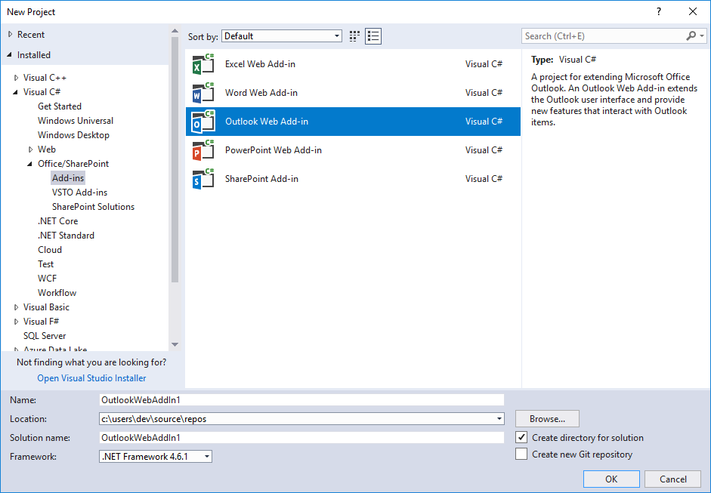
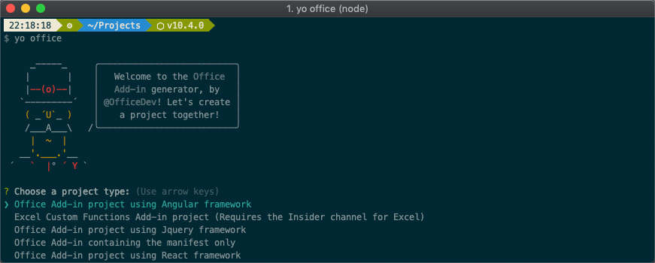
Provisioning Add-in Projects
For Visual Studio
The Visual Studio installer includes Office/SharePoint development feature for doing add-in development
For any other developer environment
The Office Yeoman Generator allows developers to provision new add-in projects for any environment
Provisioning workflow allows developers to select popular frameworks such as React, Angular, and more
Supports both Javascript and Typescript based projects
Includes self-signed certificate for testing and debugging add-ins
Notes:
When starting a new Office add-in project, your approach will differ based on using Visual Studio or not. The Visual Studio installer includes an optional Office/SharePoint development feature for doing add-in development.
If you aren’t using Visual Studio, you should leverage the Office Yeoman Generator, which uses a command line workflow for provisioning add-in projects using a number of popular frameworks and even Typescript. You can also use the Yeoman Generator to provision a manifest for an existing web project. Office add-ins must be hosted using SSL, and both these project provisioning methods handle the self-signed certificated needed to do this locally.

Slide 12
Demo
Notes:
In this demo, we will look at provisioning a mail add-in using the Office Yeoman generator and side loading it for testing

Slide 13

Summary
Outlook provides a number of ways to integration options and UX shapes for customizing the Outlook experience
New mail add-in project can be provisioned using Visual Studio or the Office Yeoman Generator

Slide 14
Reading further
Outlook add-ins overview
https://docs.microsoft.com/en-us/outlook/add-ins/index
Office Yeoman generator
https://github.com/OfficeDev/generator-office
Tutorial: Build a message compose Outlook add-in
https://docs.microsoft.com/en-us/outlook/add-ins/addin-tutorial
Outlook add-in code samples
https://github.com/OfficeDev?q=outlook

Slide 15
Thank you

